Slide 1
Home Cure Bot
Team name: call responders
College: SCETW
Zeenat Sehar
Nikhat Parveen
Syeda Aayesha Kaleem

Slide 2
The COVID-19 Track
Technology has a vital role to play. Technology cannot prevent the onset of the pandemics; however, it can help prevent the spread, educate, warn, and empower those on the ground to be aware of the situation, and noticeably lessen the impact.
This track helps engineers bring solutions for the ongoing pandemic and contribute to the world’s betterment.

Slide 3
Home Cure Bot
During this pandemic, if people want to visit the hospital for any minor illness, health complaints or injuries, they cannot do so, because neither do they want to risk going to the hospital, nor are the doctors available to treat them.
This project, is thus designed to help in such situations, where the treatment can be majorly done at home, so as to avoid going to the hospitals unless extremely necessary.

Slide 4
Scope Of The Project
This bot is helpful, as it can be used from home,and is designed to be user friendly.
The bot helps the user in the following ways:
Helps to know what steps should be taken to treat the injury or wound.
Helps to know what exactly happened, so that the user is not confused and does not take the wrong remedies.
It gives you the serious symptoms too, so that you can know when to seek medical attention.

Slide 5
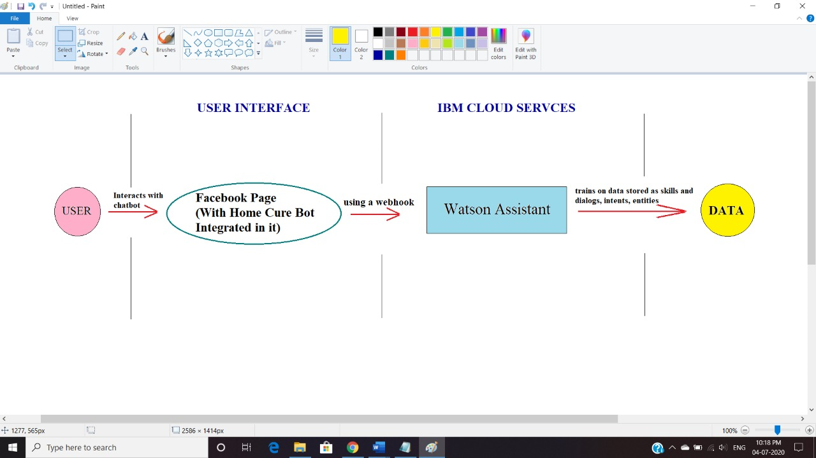
Architecture Diagram
A simple architectural diagram of the bot:

Slide 6
Future Scope
This bot gives the remedies and treatments that can be done from home. Improvements can definitely be made, such as:
Uploading an image of the injury or problem faced, so that it can tell the user what exactly happened, if the user doesn’t know.
Including few more problems like fits, fainting, head injuries etc.
Connecting to a Doctor on Facebook, if medical attention is needed.

Slide 7
THE END
Stay Home, Stay Safe.

